Slide 1

Assembly issues for DVT3 3D data

Slide 2


SPONGE_MIC_SILICON_140X24 and HOLDER MIC are still old and have not been updated.
SPONGE_MIC_SILICON_140X24
HOLDER MIC

Slide 3
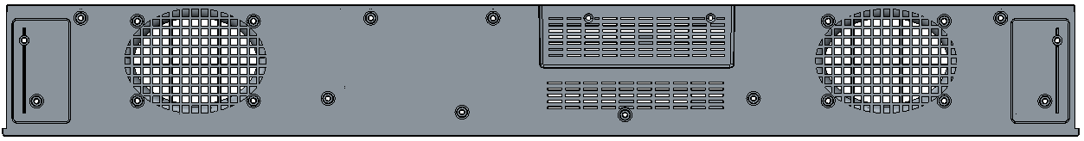
The hole at the bottom of the bottom cover is not helpful for thermal result.
So please to sealing the venting holes, it can also solve the ESD issue.

Slide 4
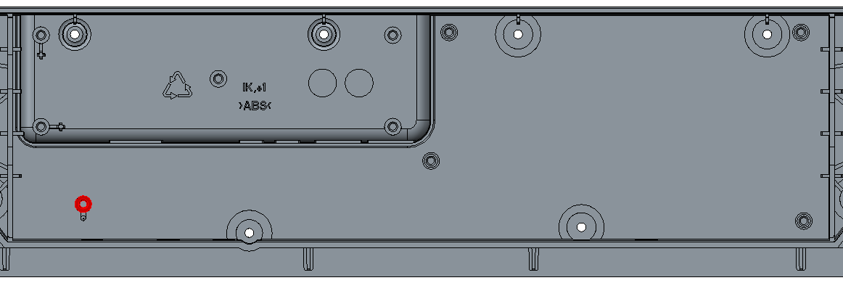
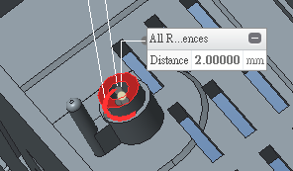
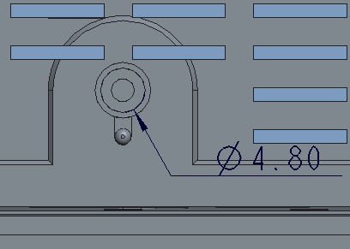
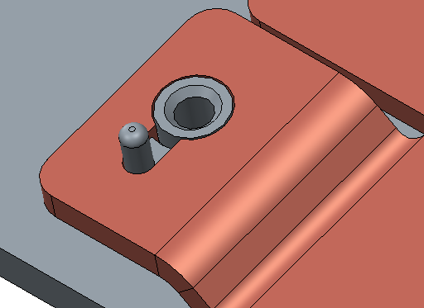
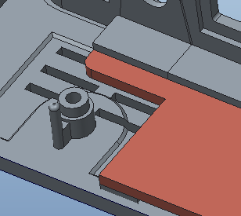
Heat spreader for DVT3 build
Need to be addedd by 2mm on screw hole
Heat spreader for DVT1 & 2 build
Please add 2mm on screw hole, so that we can also assembly the SoC board with DVT1 heat spreader samples.

Slide 5
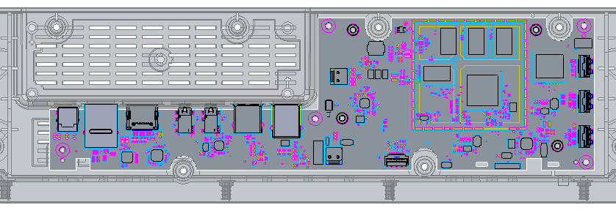
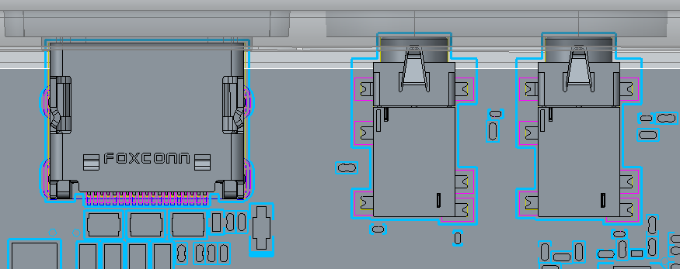
The I/O connector will interfere with bottom cover respectively when assembled

Slide 6
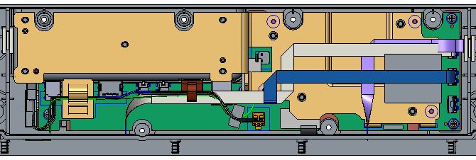
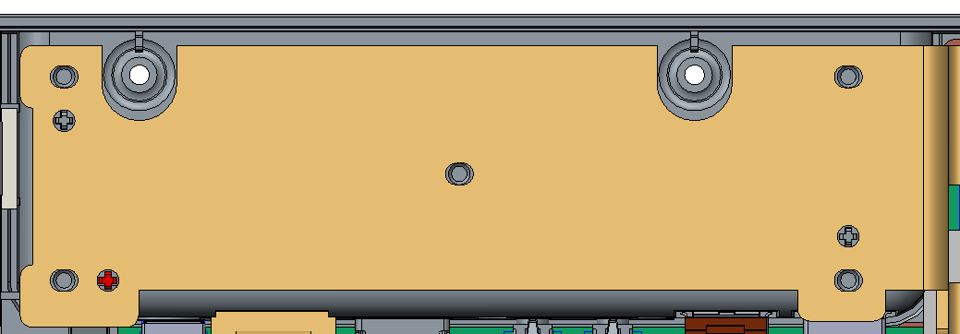
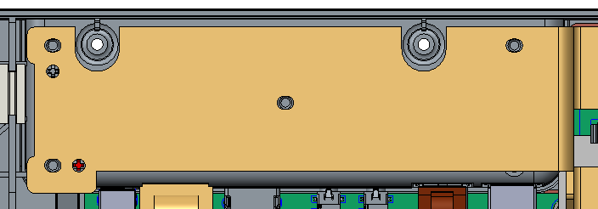
DVT3 3D data
DVT1 heat spreader
Please add the fix-boss on the left side, so that we can also use DVT1’s heat spreader samples.

Slide 7
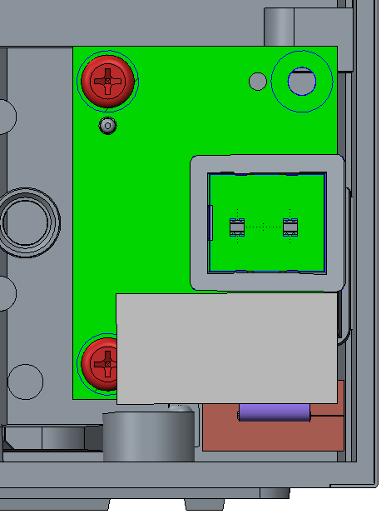
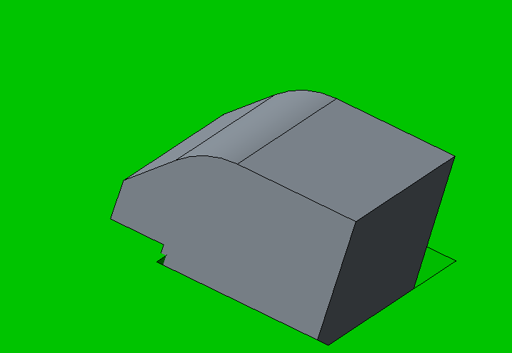
Please change the light pipe to interfere with side LED PCB for the vibration issue. So that we don’t have to add glue between LED light pipe and side LED PCB.

Slide 8
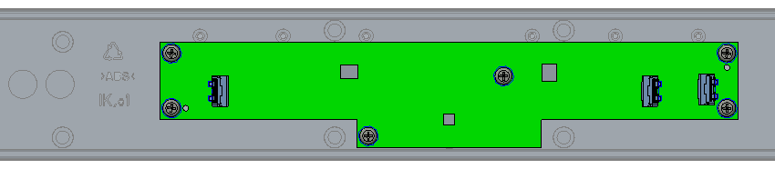
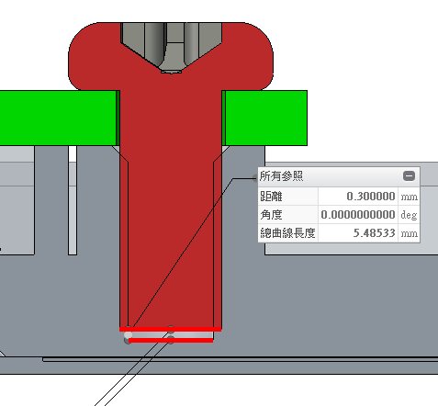
Please check whether the GRILL FABRIC ASS'Y will be damaged by screw.

